Slide 1
NASA Space Apps Challenge
Solarium Project to Grow Plants on Mars
Project Creators
Ege DAŞBACAK
Yağız ÇATLI

Slide 2
Just as no living organism can survive on Mars without protection, plants also cannot survive under Martian conditions. Similar to their requirements on Earth, plants need suitable temperatures, atmospheric conditions, and specific levels of oxygen and carbon dioxide to sustain life. Unfortunately, these conditions are not present on Mars. Due to its thin atmosphere, toxic soil, and the absence of essential organic matter and minerals required by plants, cultivating vegetation on Mars is nearly impossible.

Slide 3
To address this issue, we propose the construction of a solarium. This controlled environment will provide the necessary light, water, and other resources required for plant growth. The solarium will be powered by energy obtained from a solar panel. he reason for utilizing a solar panel is that it represents the cleanest and most accessible method of energy generation on Mars, due to the ability of photons to propagate through space. The direct current (DC) generated by the solar panel will be converted into alternating current (AC) to meet the energy demands of the solarium. The electrical flow, once converted to AC, along with the subsequent systems, will be controlled via a pneumatic pin to enable quicker response times.

Slide 5
In this circuit:
The output voltage is 8.84 V RMS,
The voltage gain is 0.177, or equivalently –15 dB,
The efficiency is 90.7%.

Slide 6
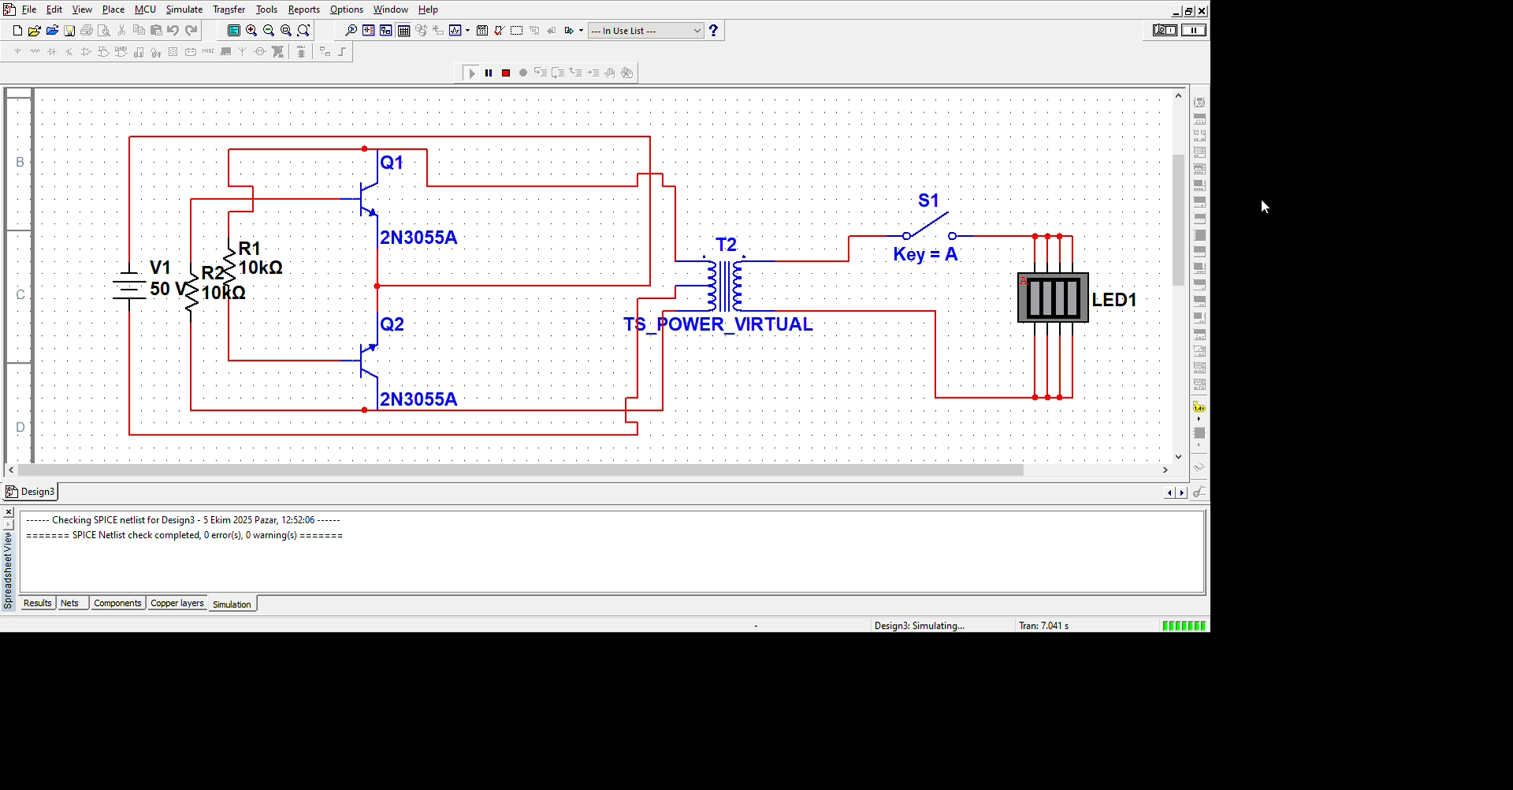

Slide 7
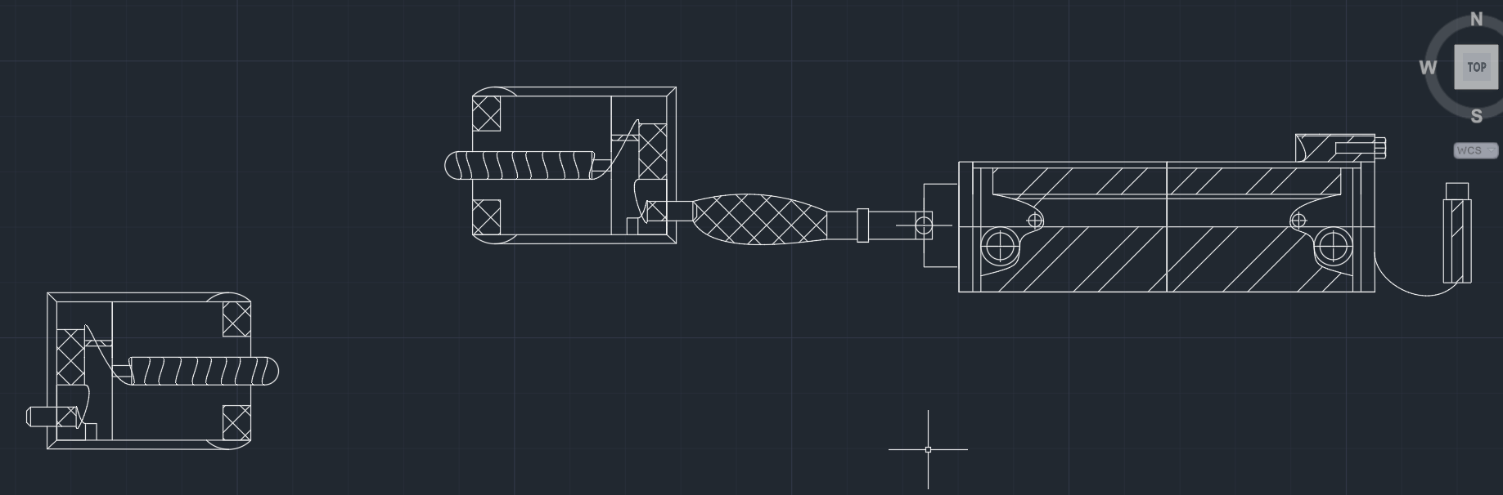

Slide 8
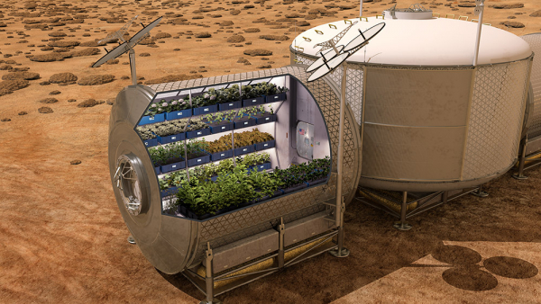

Slide 9
Sources
science.nasa.gov
tubitak.gov.tr

